Slide 1

Product/ Service Development
Session 13
Course : Software Engineering
Effective Period : Desember 2017

Slide 2
These slides have been adapted from
Osterwalder, Alexander et al. 2010. Business Model Generation: A Handbook for Visionaries, Game Changers, and Challengers. JWS. New Jersey. ISBN: 978-0470-87641-1.
Acknowledgement

Slide 3
LO 3 : Analyze the potential business project using business model framework
Learning Objectives

Slide 4
Contents
What is new product development (NPD)?
Challenges in NPD
Overcoming these challenges
NPD Strategies
New product failures
Stages in NPD
Conclusion

Slide 5
What is New Product
Development?
New product development (NPD) is the term used to describe the complete process of bringing a new product to market.
A product is a set of benefits offered for exchange and can be tangible (that is, something physical you can touch) or intangible (like a service, experience, or belief).

Slide 6
Challenges in New Product
Development
New Product development challenges fall into three major categories:
Definition of product specifications
Time and resources issues
Interactions of the Product Development group with the rest of the company

Slide 7
How to overcome these
Challenges??
Assess the projects financial value before the development starts.
Prioritize projects according to clear criteria.
Let Marketing professionals define the target
Market and specify the product upfront.
Involve all the functions of the companies at the product selection stage.
Align project targets and resources.

Slide 8

New Product Development Strategy
How do companies develop and market new products?
  Come up with own ideas.
    Brand new products
    Product improvements & modifications
  Acquire companies, patents, licenses.
  E.g.: Tata Nano car

Slide 9

New-Product Failures
Only 10% of new consumer products succeed in the long run.
Why do most products fail?
  Don’t fulfill a real need or want
  Overestimation of market size
  Design problems that compromise functionality
  Incorrectly positioned, priced or promoted (4 P’s)
  Pushed despite poor marketing research findings
  Development costs go over budget
  Competitive response

Slide 10
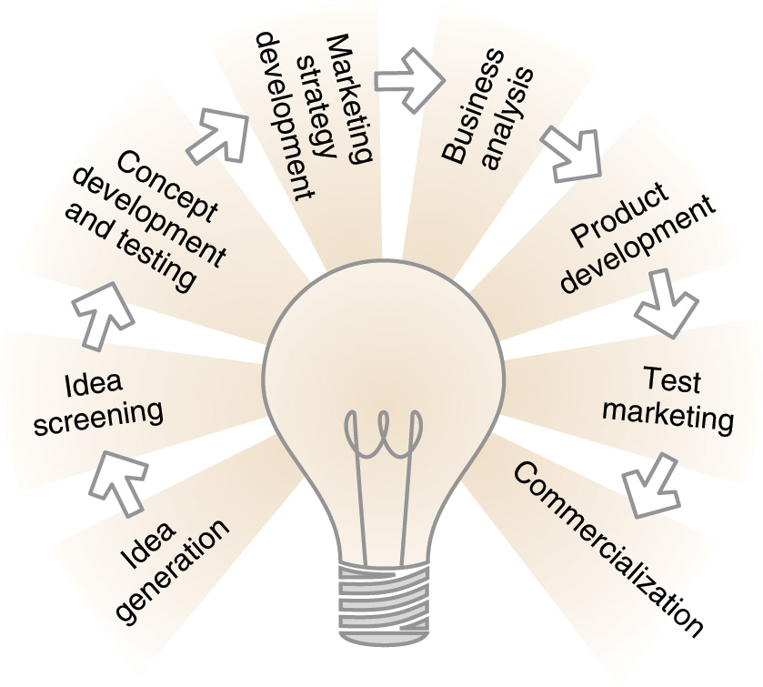
Major Stages in New-Product Development Process

Slide 11

Idea Generation
Where do ideas come from?
Internal sources:-
  Company employees at all levels: “Intrapraneuring”
External sources :-
  Customers
  Competitors
  Distributors
  Suppliers
  Outsourcing partners

Slide 12
Idea Screening
Keep the good ideas and drop the poor ones.
Criteria :
  Market Size
  Product Price
  Development Time & Costs
  Manufacturing Costs
  Rate of Return

Slide 13


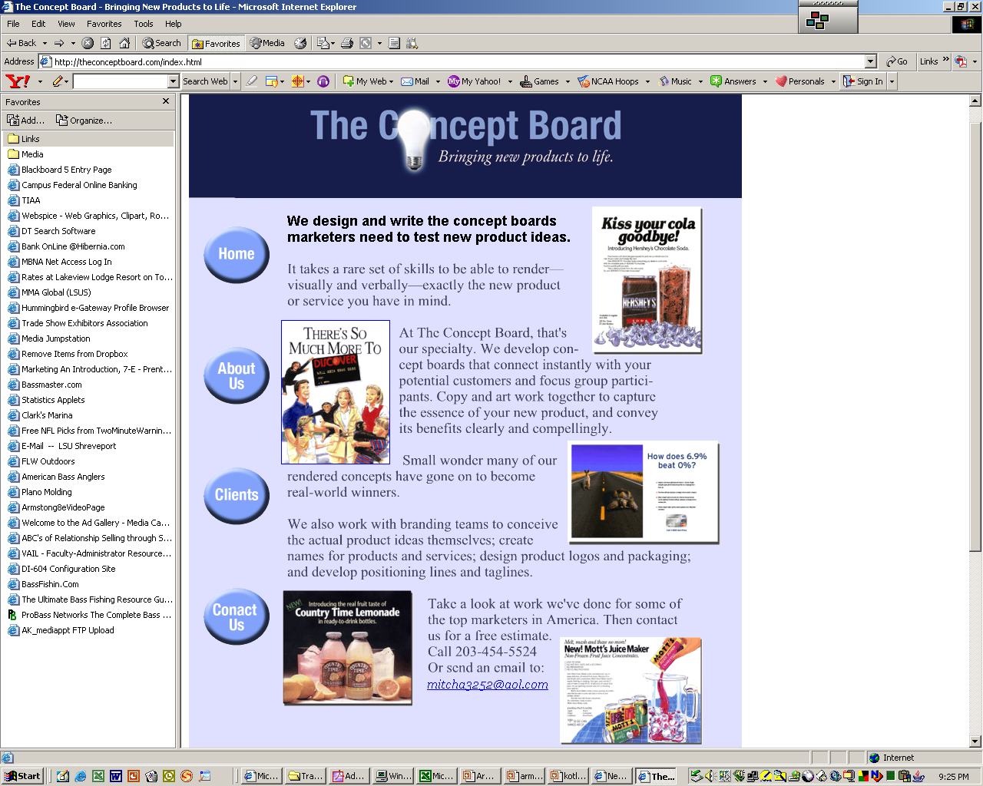

1.Develop a working description and
visualization of the product idea
and concept.
Concept Development and
Testing:
2. Concept Testing - Test the
Product Concepts with Groups
of Target Customers
3. Choose the Best One

Slide 14
Marketing Strategy
Development:
Part One - Overall:
Target Market
Planned Product Positioning
Sales & Profit Goals
Market Share
Part Two - Short-Term:
Product’s Planned Price
Distribution
Marketing Budget
Part Three - Long-Term:
Sales & Profit Goals
Marketing Mix Strategy

Slide 15
Business Analysis
Review of Product Sales, Costs,
and Profits Projections to See if
They Meet Company Objectives
Business Analysis
Assess economic viability of the concept.
If No, Eliminate
Product Concept
If Yes, Move to
Product Development

Slide 16
Product Development
Develop concept into physical product prototype.
Large jump in investment – “point of no return”.
Test and refine prototype until product passes consumer and legal scrutiny.

Slide 17

Test Market:
Standard
Test Market
Full marketing campaign
in a small number of
representative cities.
Controlled
Test Market
A few stores that have
agreed to carry new
products for a fee.
Simulated
Test Market
Test in a simulated
shopping environment
to a sample of
consumers.
After test marketing the “Go Active” meal (an adult happy meal) in 150 markets in Indiana, McDonald’s decided to sell it across the U.S.

Slide 18
Commercialization:
Broad launch of product if market test results are positive.
Timing of launch is important.
Potential Rollout plans
  Local
  Regional
  National
  International
  “Wider Test Market”

Slide 19
Conclusion
Implementation of a NPD process with stages has helped businesses focus their New Product investment on the most potentially rewarding projects.
It has shortened the time between idea and revenue by orchestrating the complex set of activities required for the commercial success of new products.

Slide 20
References
Alexander Osterwalder & Yves Pigneur, Business Model Generation, John Willey & Sons. Inc. Hoboken, New Jersey, United States of America, 2010, ISBN: 978-0470-8764-1 (BMG)
Schaper, Michael.(2011). Entrepreneurship and Small Business 3-rd Asia-Pasific Edition. John Wiley & Sons Autralia, Ltd. Milton. ISBN: 978-1-74216-462-5. (ESB)

Slide 21
Q & A

